Slide 1
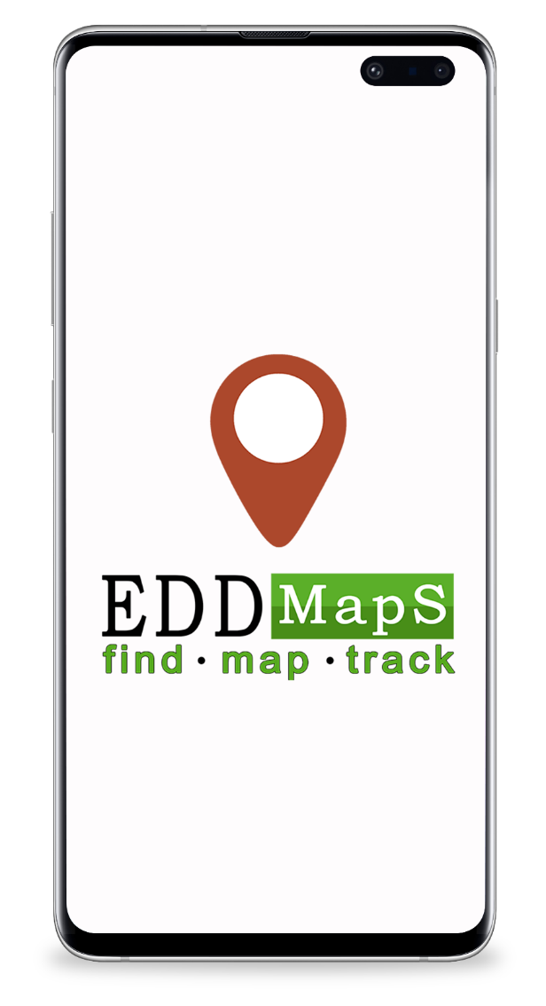
How to Report Using the EDDMapS Smartphone App

Slide 2
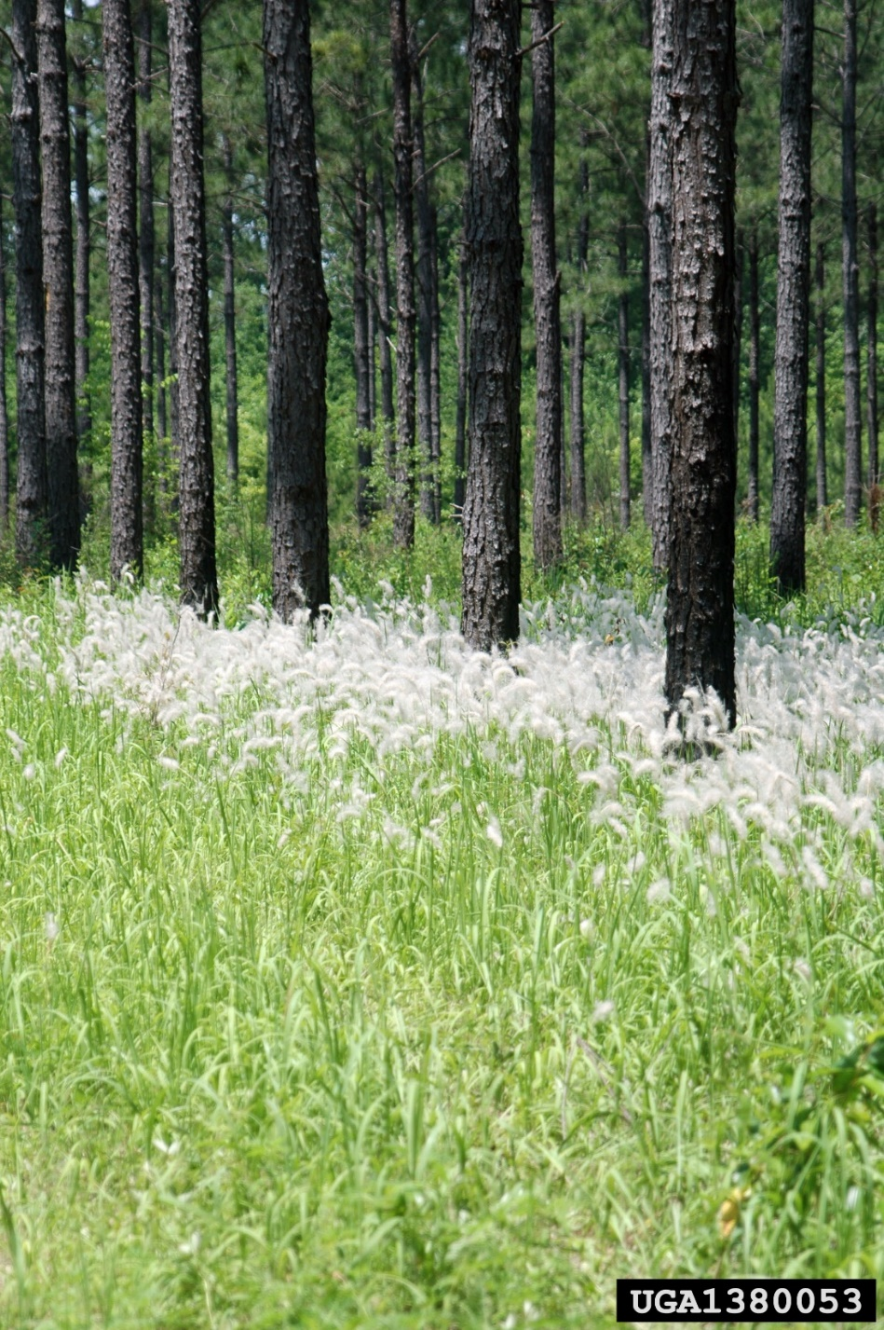
What is EDDMapS?
EDDMapS, the Early Detection & Distribution Mapping System, is a web-based mapping tool for documenting invasive species distribution across the United States.
Launched in 2005 by the Center for Invasive Species and Ecosystem Health at the University of Georgia, this tool documents the presence of invasive species and provides real-time tracking of new infestations.
Chris Evans, University of Illinois, Bugwood.org

Slide 3
Why use EDDMapS?
Invasive species are extremely challenging because they invade our native ecosystems and will continue to grow and spread.
We must actively seek solutions to control or eradicate the species which are problems already or have the potential to become problems.

Slide 4
What happens to your EDDMapS records?
Real time tracking of species
Facilitate Early Detection and Rapid Response programs (EDRR). EDRR programs help stop or control an invasive species before it becomes an unmanageable problem.
Data is made freely available to scientists, researchers, land managers, land owners, educators, conservationists, ecologists, farmers, foresters, state and national parks.
National Parks Service

Slide 5
Download EDDMapS App
Download the EDDMapS app on Google Play or the Apple Store

Slide 6
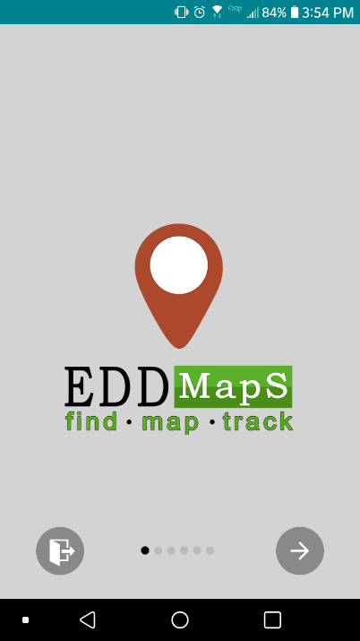
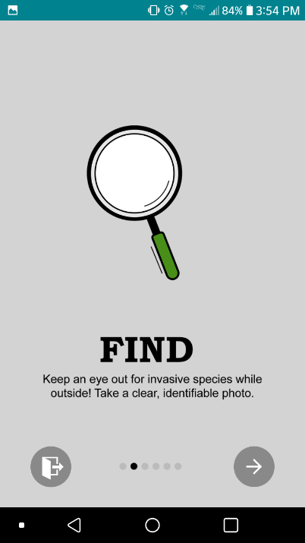
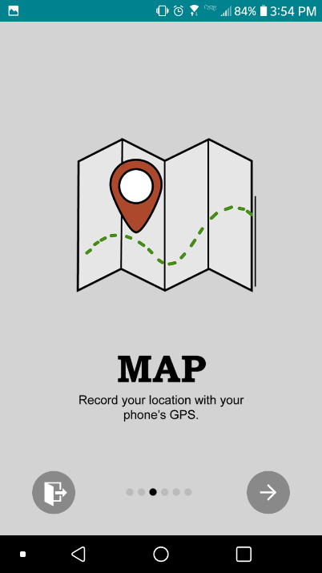
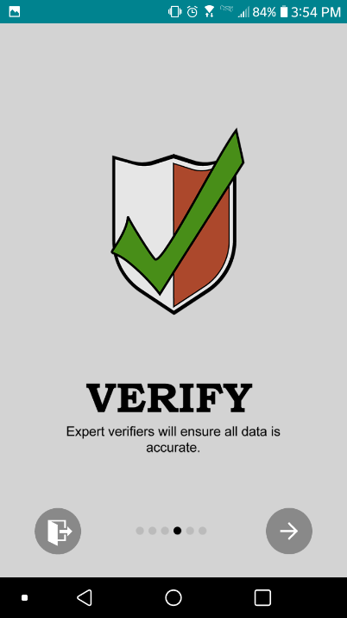
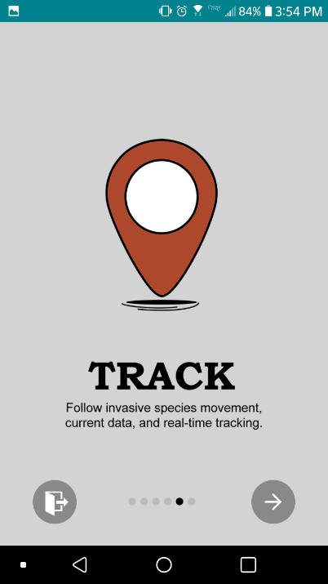
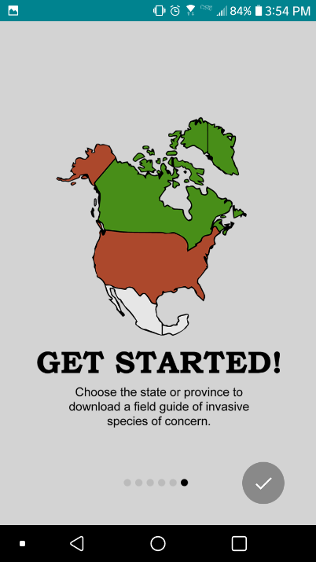
Getting Started
Begin by swiping through initial informational slides after downloading the EDDMapS app

Slide 7
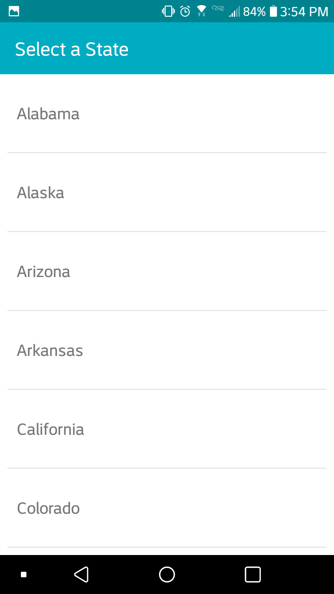
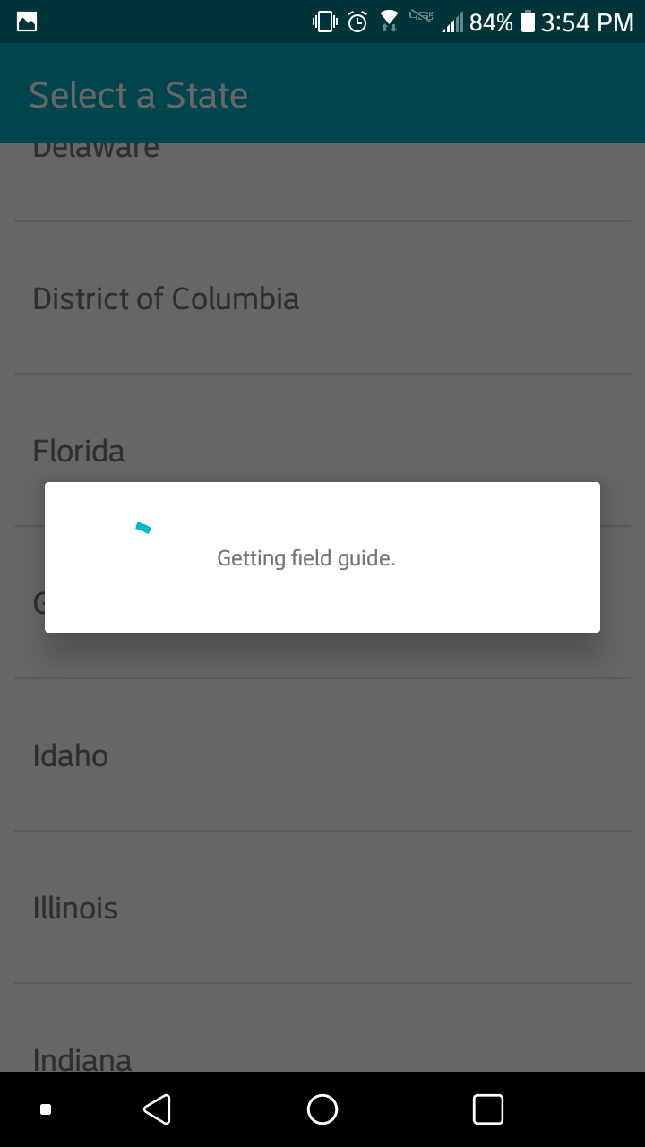
Field Guides
Select your state to download state based field guide.

Slide 8
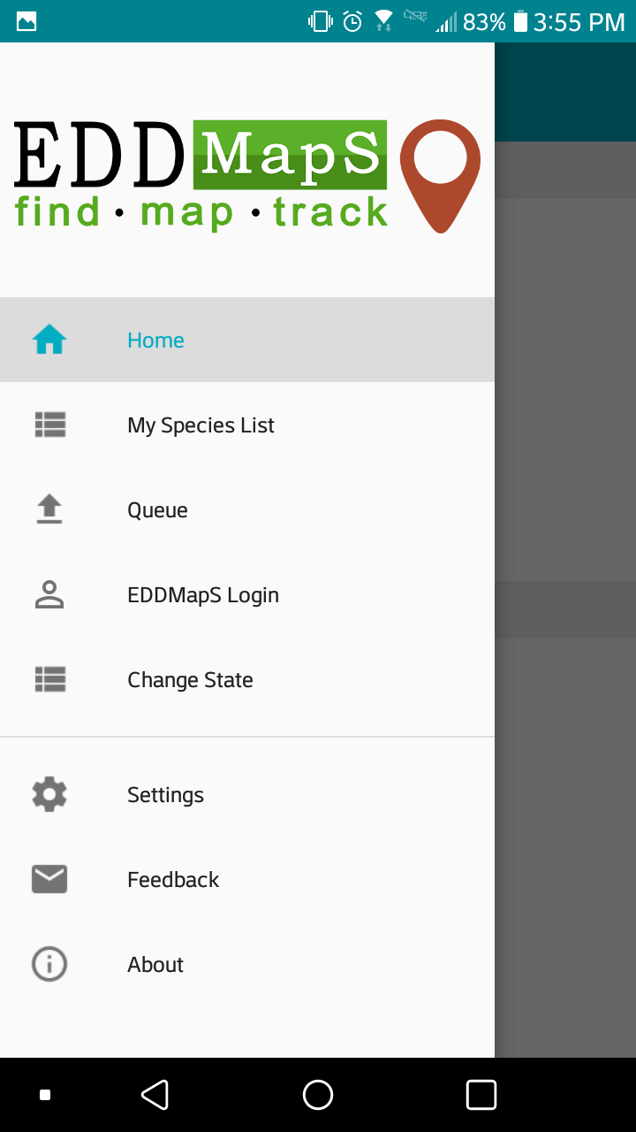
Home
Navigation page for reporting observations and finding species information
My Species List
Custom list each user can create for quick reporting
Queue
Records saved to the app which have not yet been sent to the EDDMapS Database
EDDMapS Login
Register with EDDMapS or Login with your username/email and password
Change State
Select your state to download a state based field guide
Settings
Notifications, selected Field Guide, Dark Mode, Save Report images to gallery
Feedback
Provide information about any issues with the app
About
An overview of EDDMapS and invasive species

Slide 9
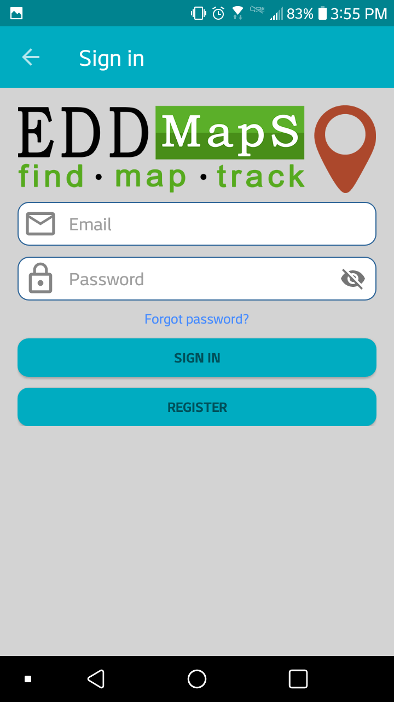
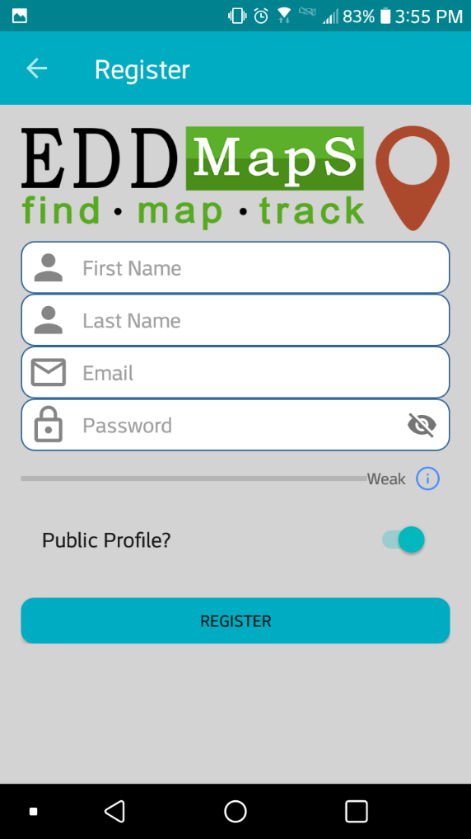
Register a New Account
Fill in the Registration form with appropriate information
Login
Sign in to an existing EDDMapS account by using your email address/username and password
Private or Public Profile?
*we will not share your information but verifiers may contact you

Slide 10
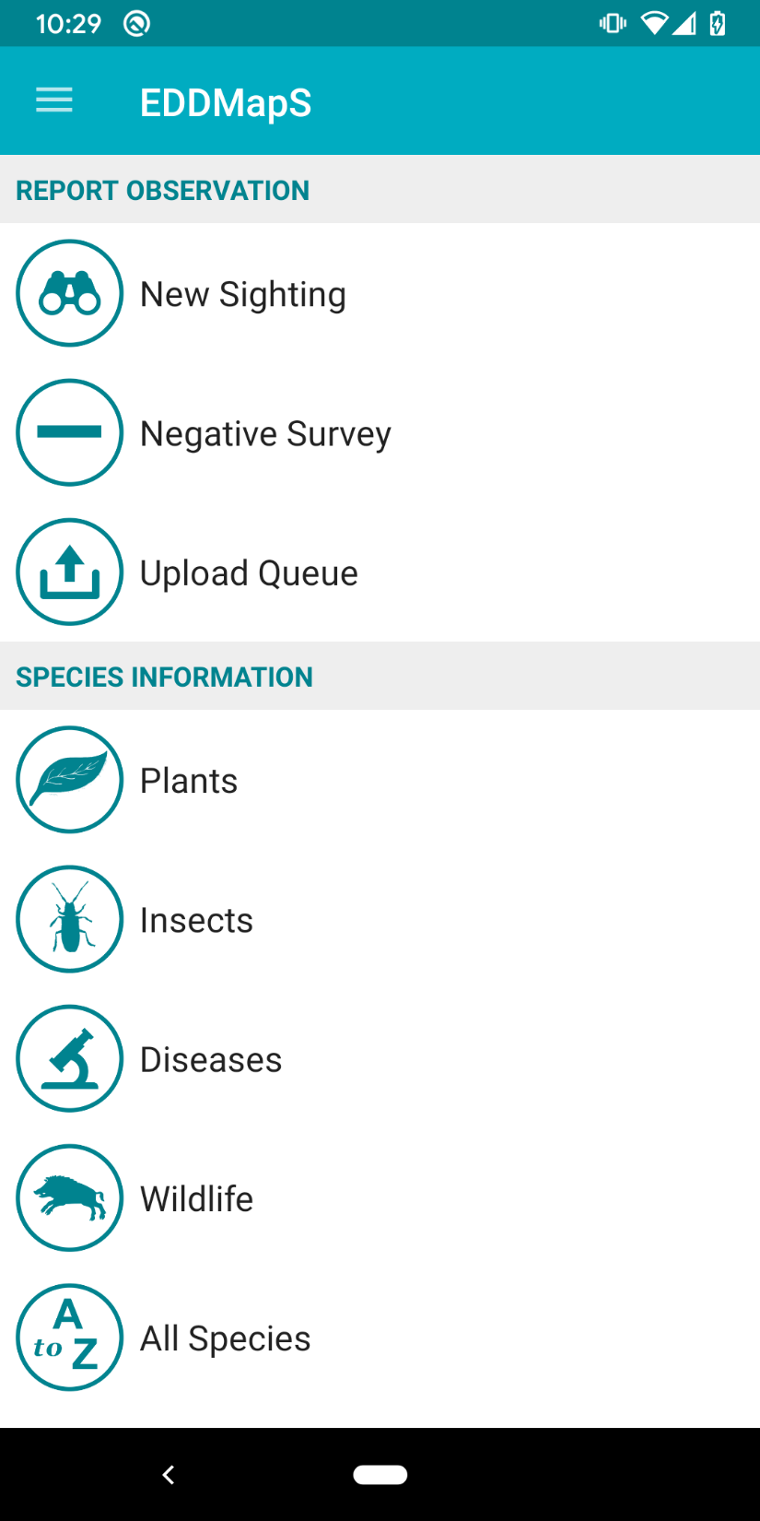
Navigate to create a New Sighting, report a Negative Survey, or review your Upload Queue
Select the category of invasive species (Plants, Insects, Diseases, Wildlife) you are interested in or select All Species to bring up the entire state’s Field Guide list
Tap any category to open a species field guide

Slide 11
New Sightings (Positive Survey Report)

Slide 12
New Sighting
This reporting form is to document species which were surveyed for in a defined area and were found

Slide 13
Species* that you’ve selected to report
Tap the image icons to add a photo to the report
Observation Date* can be changed by tapping on the date
Hide exact location? Select to mask GPS location of report
Location* Tap the map to check your location, drop/move map point or draw polygons to note area of infestation
*Data is auto-filled **Data is auto-filled if polygon is drawn

Slide 14
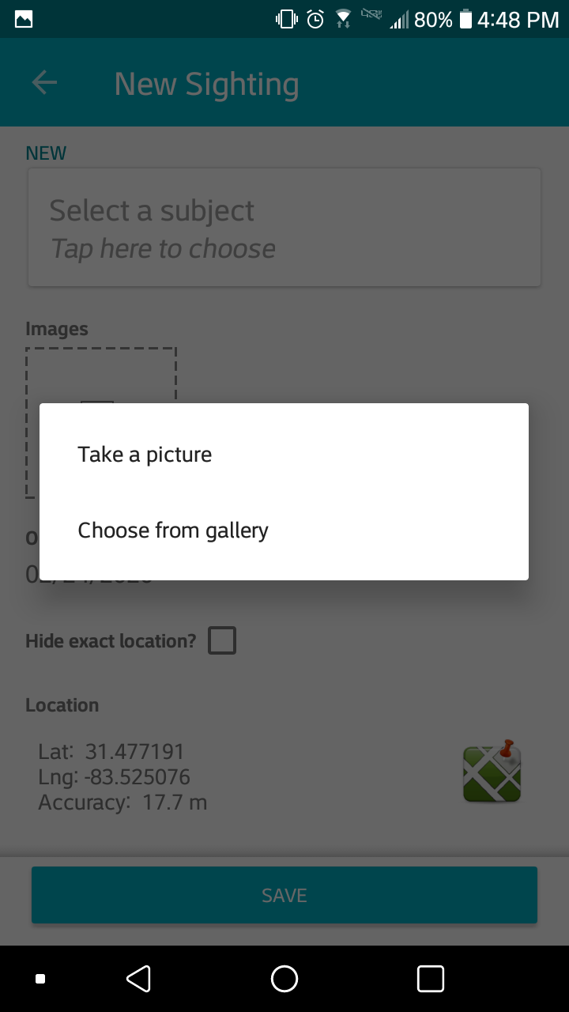
Tap the image icons to add a photo to the report

Slide 15
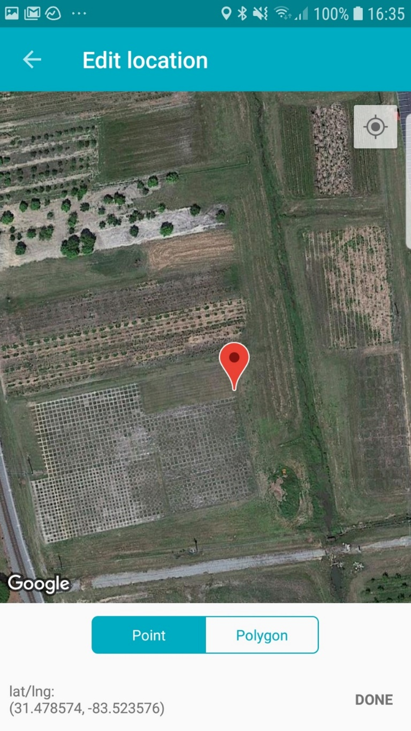
Tap the map icon to check your location, drop/move map point or draw polygons to note area of infestation

Slide 16
Tap to center the map on your current location
Tap to place point on map
Tap Point to note a single plant or small infestation
Tap DONE to save point location

Slide 17
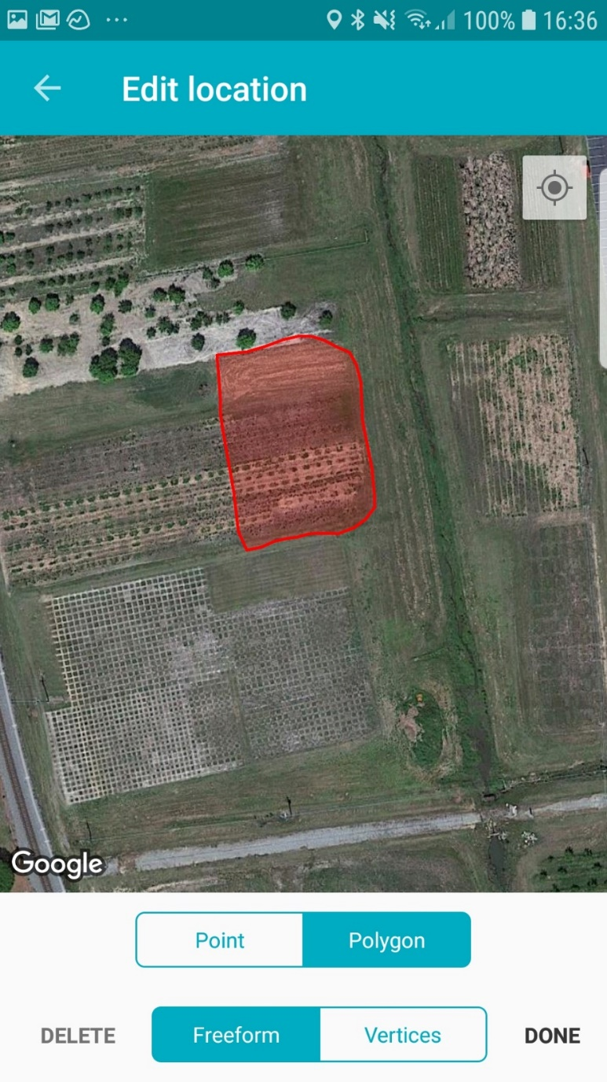
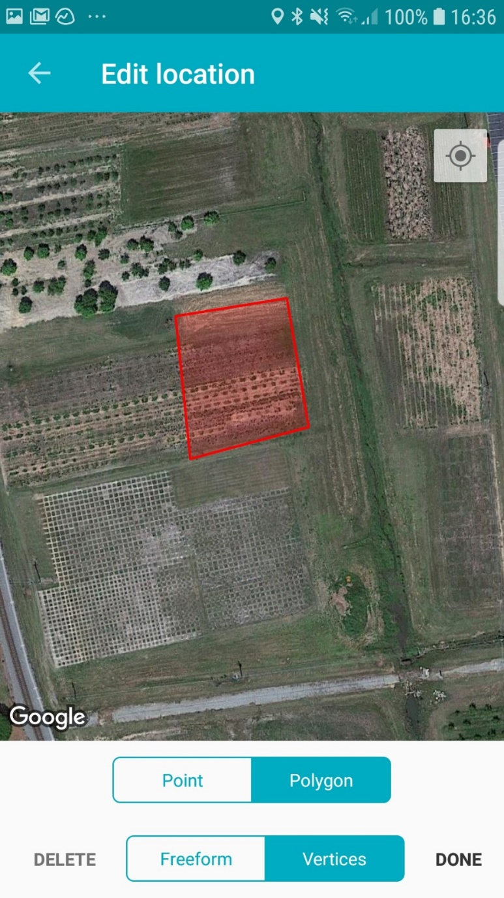
Polygon – Freeform (drag finger to draw perimeter of the infestation)
Polygon – Vertices (Tap at the corners of the infestation to draw perimeter)
Tap DONE to save Polygon location
Tap the DELETE to remove the polygon and redraw
Tap to select Freeform
Tap to select Vertices

Slide 18
Infestation Status
Positive ─ Subject was present at time of report
Treated ─ Subject was present at time of report and control efforts (e.g., mechanical, chemical, etc.)
Negative ─ Subject was present previously but is not at time of survey and has been determined to be removed from the area surveyed
Time spent surveying is great for volunteer hours!
Infestation size**
Density of infestation
Be sure to save your report to the Upload Queue
*Data is auto-filled **Data is auto-filled if polygon is drawn

Slide 19
Negative Survey Reports

Slide 20
Negative Survey
This reporting form is to document species which were surveyed for in a defined area and were NOT found

Slide 21
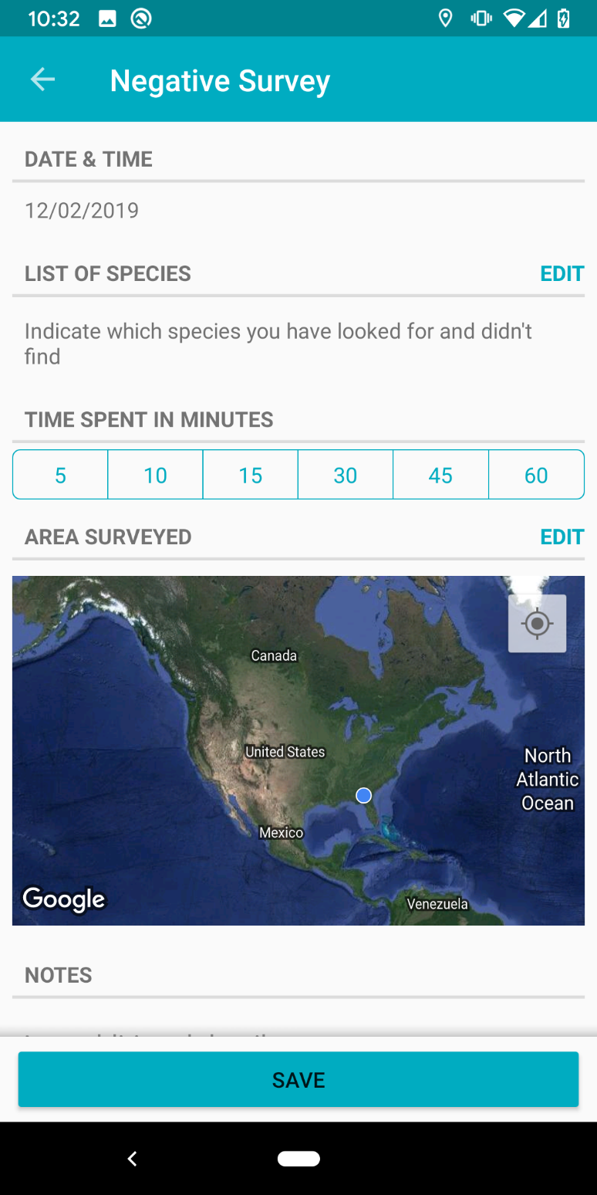
Observation DATE & Time* can be changed by tapping on the date
Tap EDIT to select species surveyed for and NOT found in the Negative Report
Time spent surveying is great for volunteer hours!
Tap EDIT in AREA SURVEYED to go to the map to draw a polygon of the area surveyed
Be sure to save your report to the Upload Queue
*Data is auto-filled

Slide 22
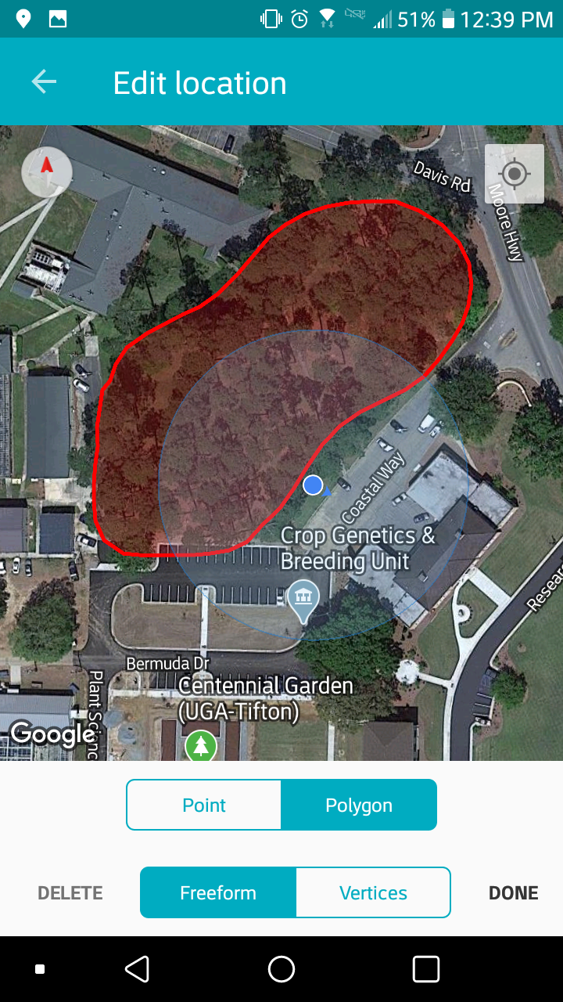
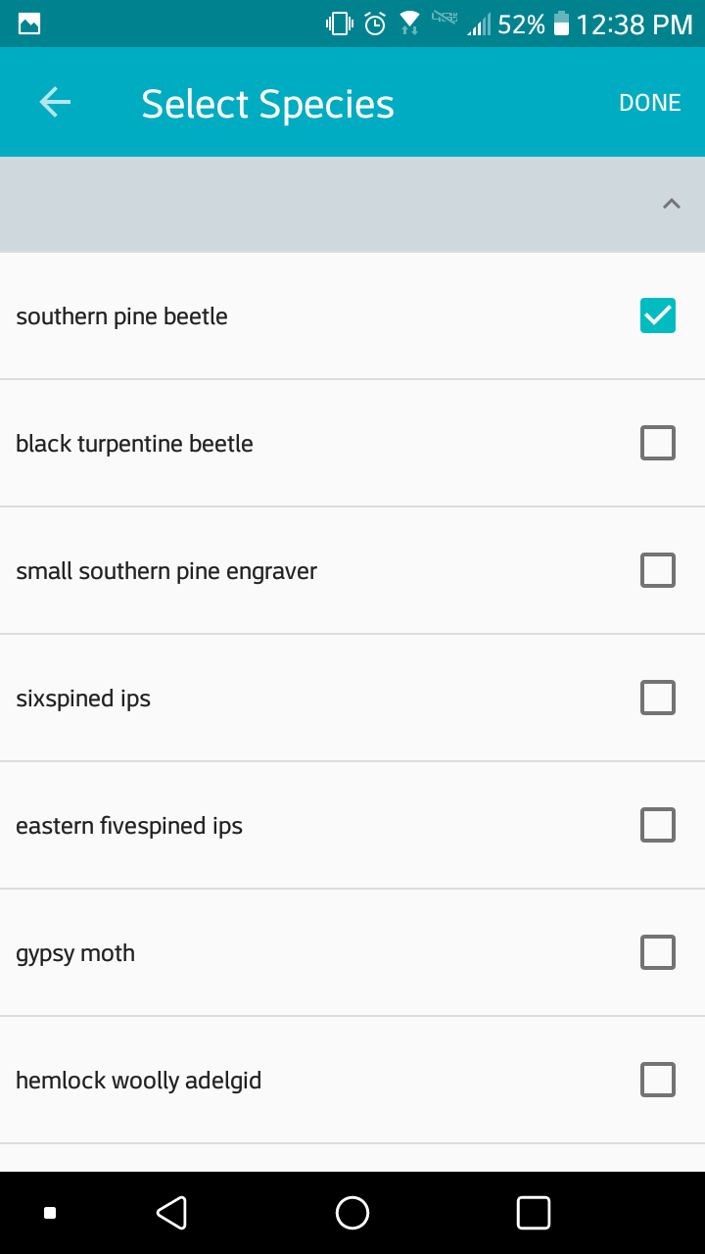
Tap DONE to save species
Edit Area Surveyed to draw a polygon
Tap to select species
Tap DONE to save location
Select Freeform or Vertices

Slide 23
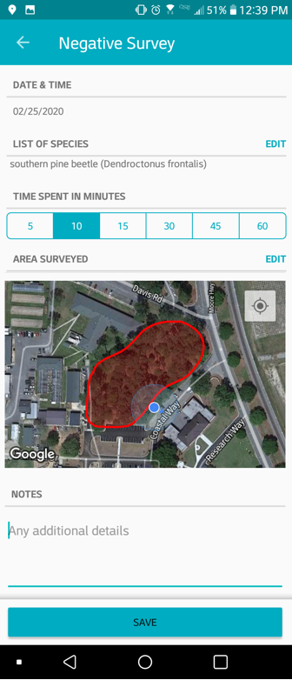
Evaluate information entered for Negative Survey Report for accuracy
Be sure to save your report to the Upload Queue

Slide 24
Submitting Reports

Slide 25
Upload Queue
Reports (Negative and Positive) are stored until user is ready to upload*.
A successful upload will empty the queue.
*Uploading require access to Wi-Fi or mobile data, once verified, reports are added to the EDDMapS’ maps

Slide 26
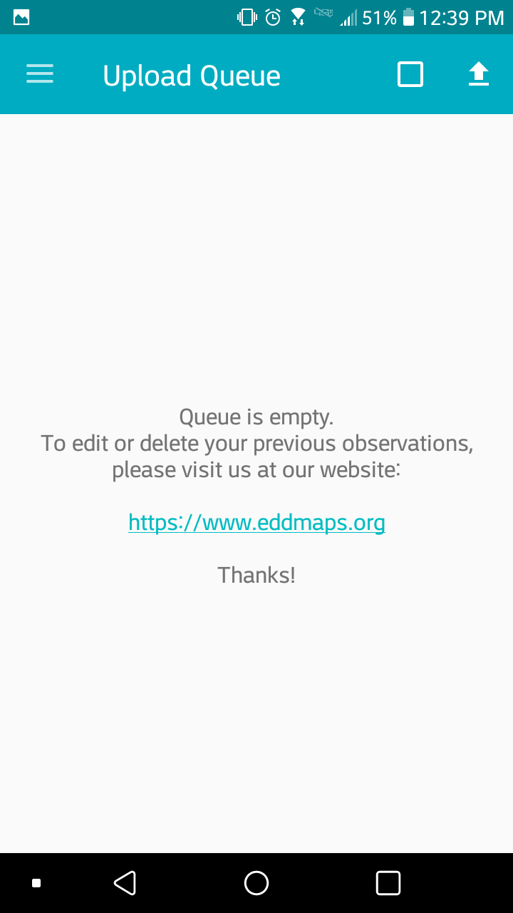
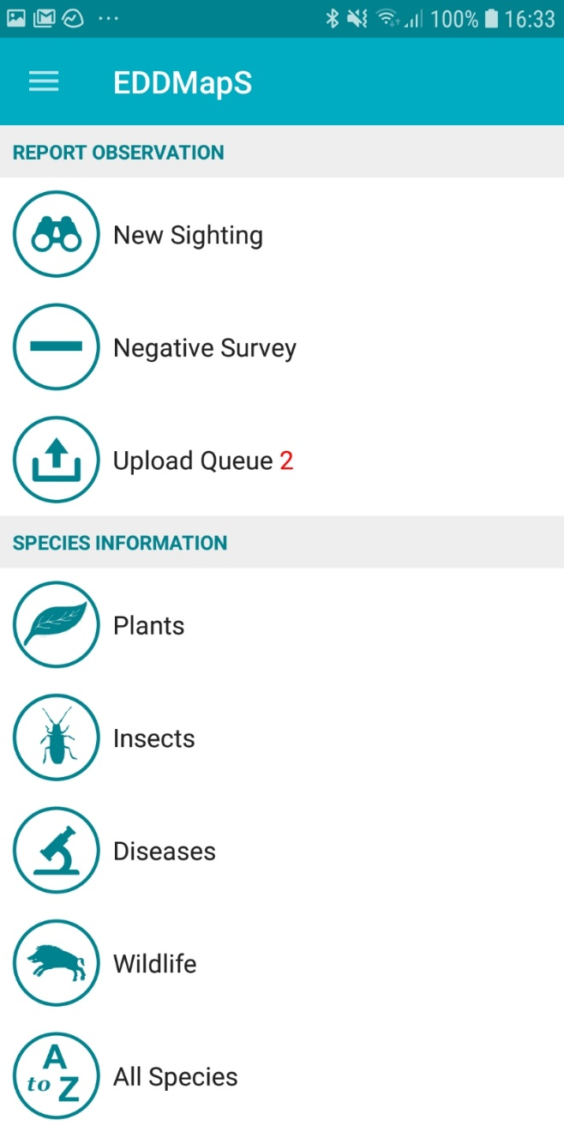
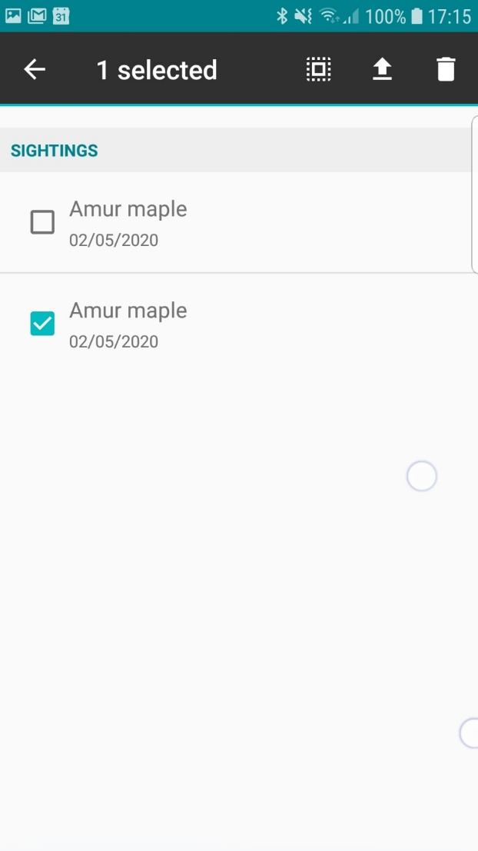
Tap to select report
Tap UPLOAD ARROW to submit reports to the EDDMapS Database
Delete Report
Tap the TRASH CAN icon to delete selected reports
Edit Report
Tap report to reopen the reporting form

Slide 27
Invasive Species Information

Slide 28
Species Information
Select the category of invasive species (Plants, Insects, Diseases, Wildlife) you are interested in or select All Species to bring up the entire state’s Field Guide list
Tap any category to open a species field guide

Slide 29
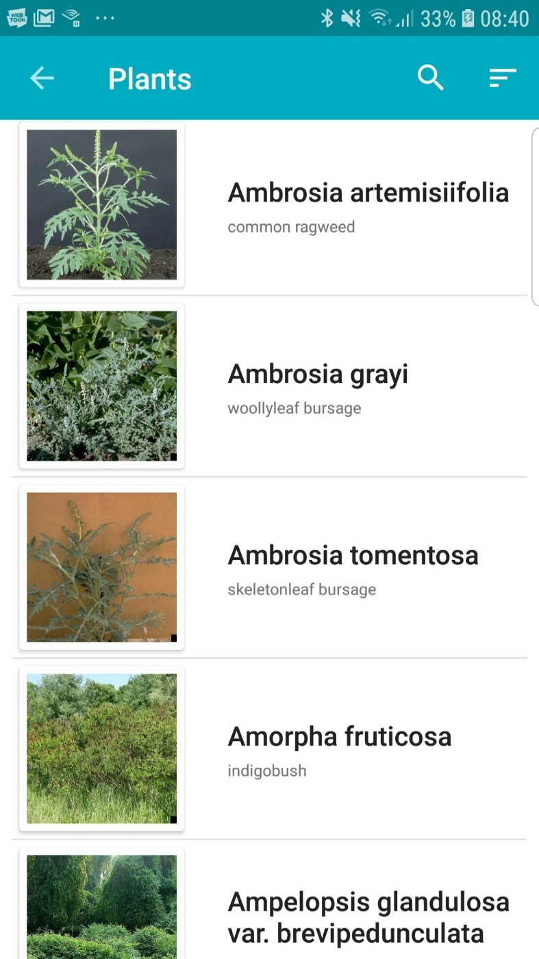
Sorting and searching features are also present within all of the Plants, Insects, Diseases, and Wildlife categories
Sort A-Z
by Common or Scientific names

Slide 30
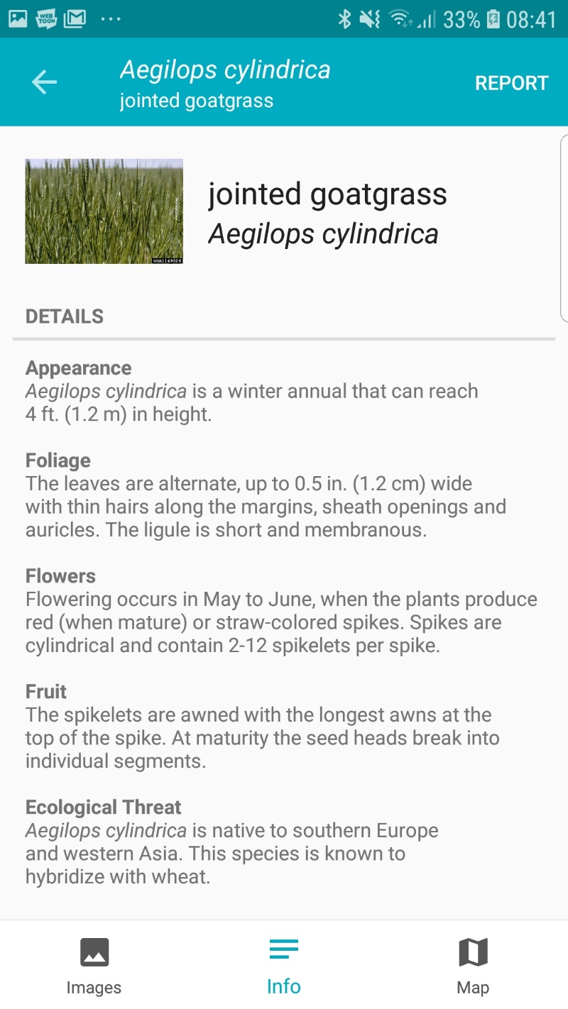
Tap REPORT to go to the reporting page for this species
*Tap MAP to go to the current point distribution map for this species
Tap IMAGES to see pictures of this species
Tap INFO to see a description of this species

Slide 31
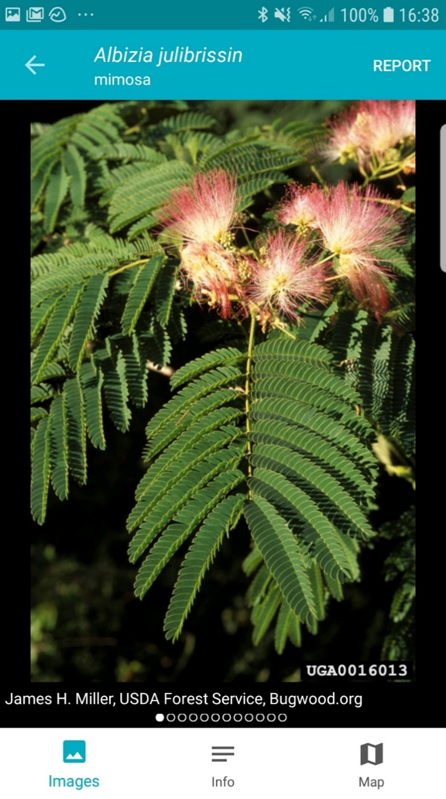
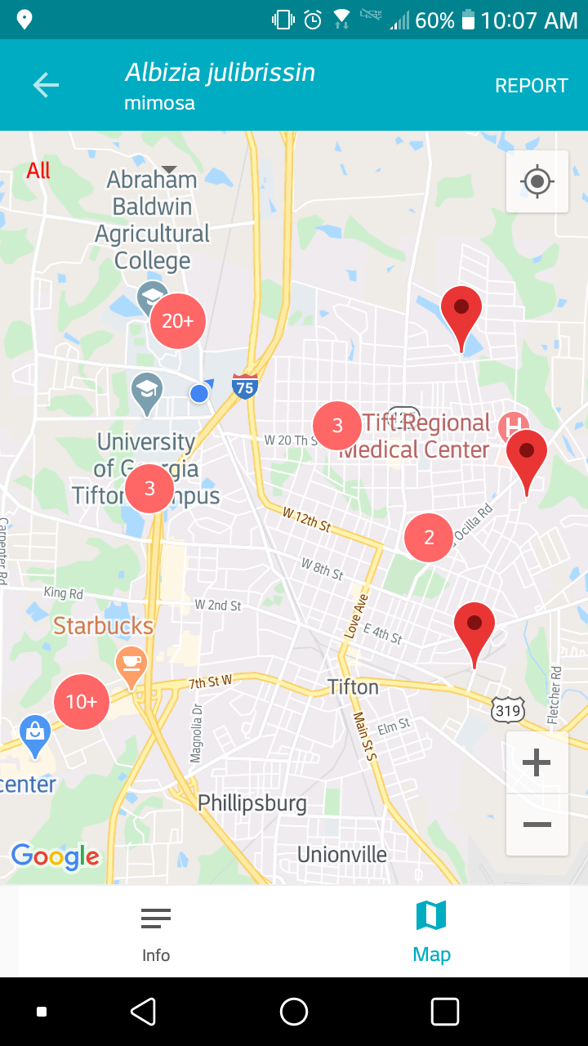
IMAGES shows identifying characteristics of the species
MAP shows the current point distribution of the species**
* Swipe left and right to view additional images
** Must have Wi-Fi or mobile data to show map

Slide 32
My Species List

Slide 33
My Species List
Custom list each user can create for quick reporting

Slide 34
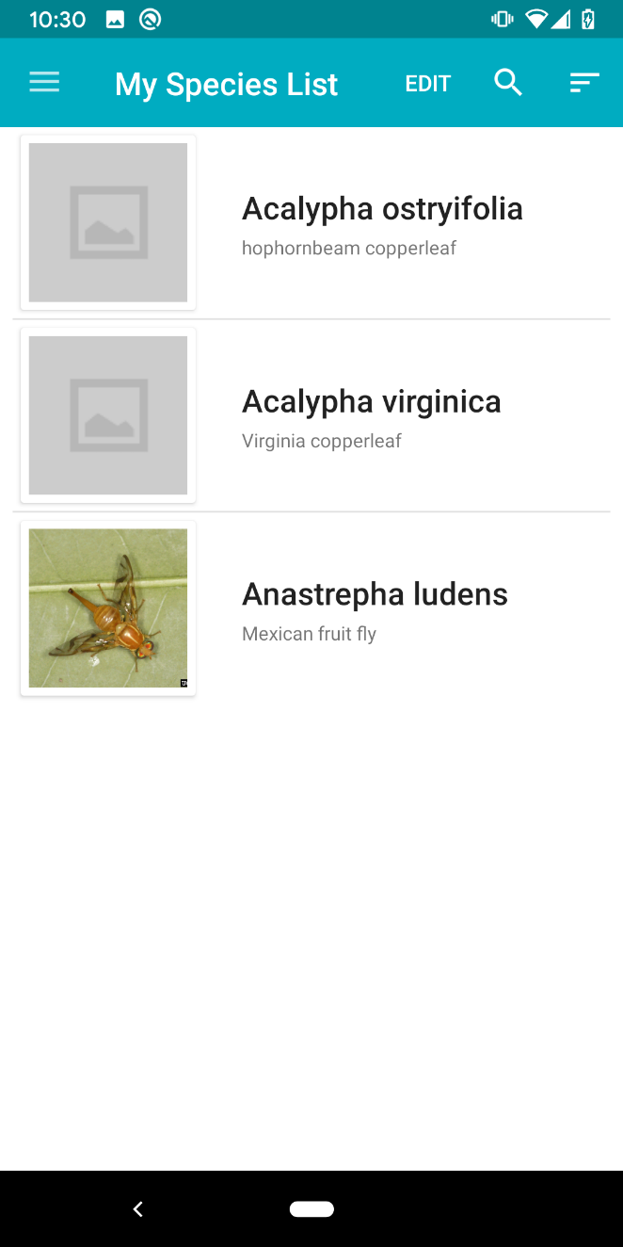
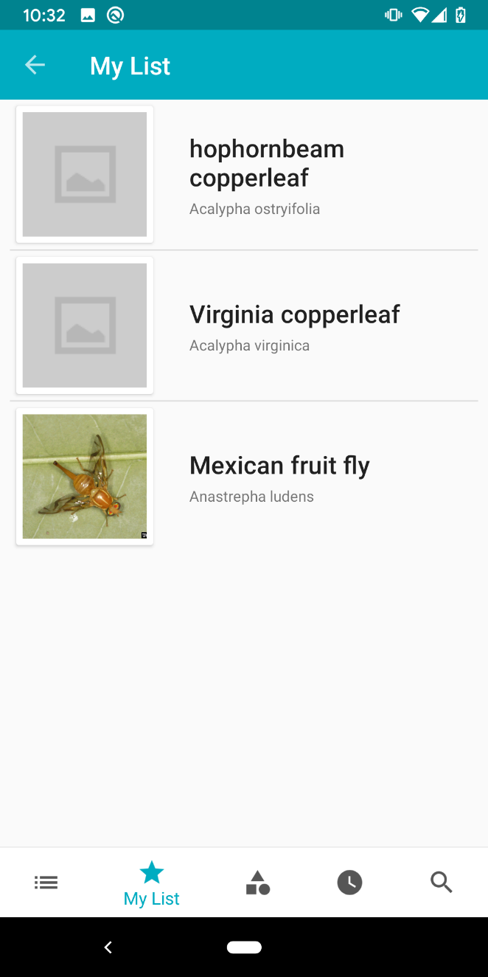
Sort A-Z
by Common or Scientific names
Tap DONE to save species
Tap EDIT to add or remove species on My List
Tap on the name to report that species
Tap to select species

Slide 35
Other Options

Slide 36
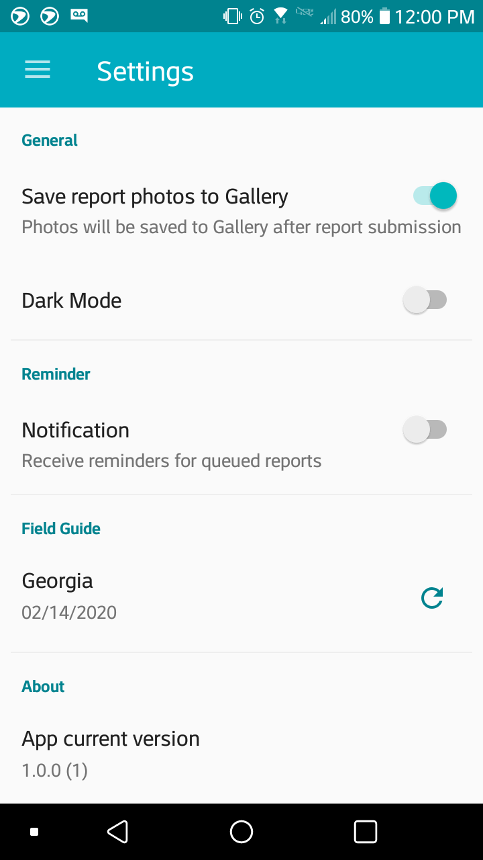
Settings
Notifications, selected Field Guide, Dark Mode, Save Report images to gallery

Slide 37
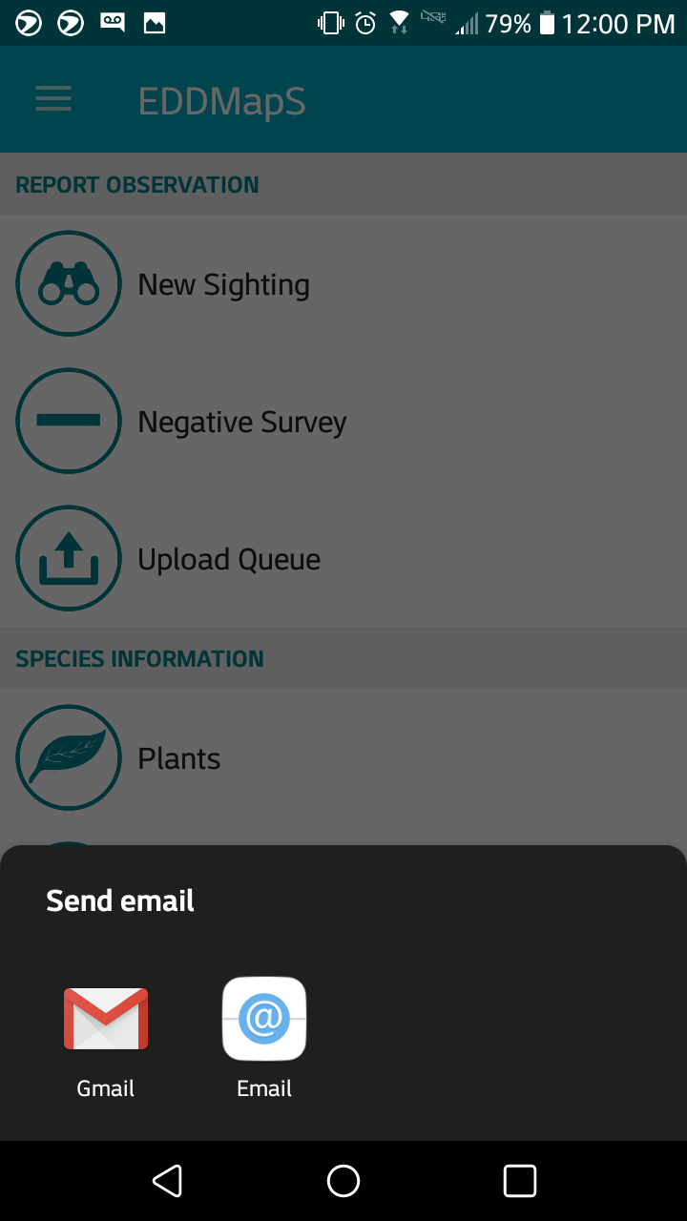
Feedback
Provide information about any issues with the app

Slide 38
About
Provide information about any issues with the app

Slide 39
Additional Information
To access reports:
Visit www.eddmaps.org
Login with email address/username and password
Click on My EDDMapS
From here, you can search for reports, view, revisit, edit, and/or delete reports as needed
To report a species not in App
Select Unknown Animal or Unknown Plant if you don’t know what the species is
Select Unlisted Animal or Unlisted Plant if you do know the species; add species name in the comments
When you upload the report, you will receive an email requesting that you update the species name if you are able

Slide 40
Additional Information
^{More Apps? apps.bugwood.org}
^{More Info? www.invasive.org}
More Bugwood websites? www.bugwood.org
^{Additional Questions?}
Contact Rebekah Wallace at bekahwal@uga.edu

